Slide 1

OUROBOROS
Team 16: Penguins
Hackathon 2017 at NBG
Papageorgiou Alexandros
Amourianos Dimitris
Antoniou Petros
Noukou Anna

Slide 2
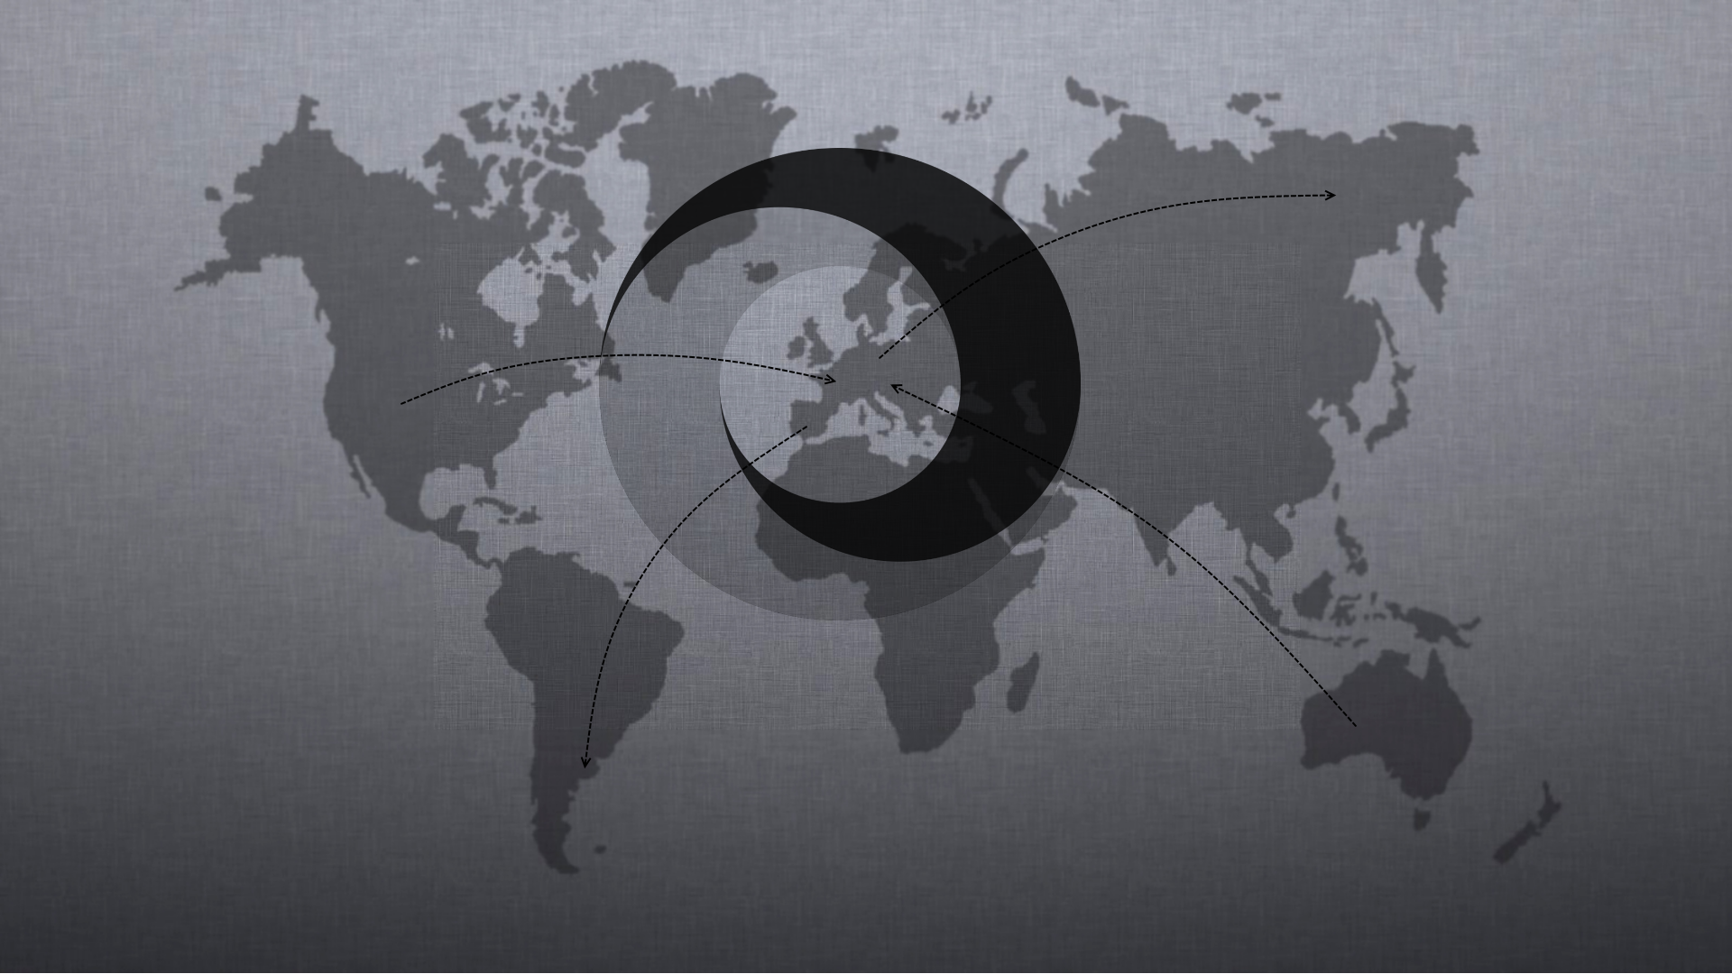

Slide 3


Slide 4
